Slide 1
Architectural Practice Examination
2025

Slide 2
APBSA acknowledges the Kaurna people, Traditional Custodians of the land in which we meet today and pay our respects to their Elders past and present. We extend that respect to the Aboriginal and Torres Strait Islander peoples here today.

Slide 3
PEOPLE Registrar Sue Crawford registrar@archboardsa.org.au Administration Coordinator Georgina Dungey admin@archboardsa.org.au SA and National Convenor Paul Boyce SA Deputy Convenor Katrina Worssam
APE - Architectural Practice Examination

Slide 4
APE - Architectural Practice Examination
ORGANISATIONS
APBSA Architectural Practice Board of South Australia
https://www.archboardsa.org.au
AACA Architects Accreditation Council of Australia
https://www.aaca.org.au
AIA Australian Institute of Architects
https://www.architecture.com.au
ACA Association of Consulting Architects
https://aca.org.au

Slide 5
APE - Architectural Practice Examination
THE Six Pathways to Registration IN South Australia
Australian Accredited Architecture Qualification
Overseas Qualifications Assessment [OQA]
National Program of Assessment [NPrA]
Overseas Experienced Practitioner Assessment [OEPA]
Local Experienced Practitioner Assessment [LEPA]
Mutual Recognition
Pathways 1, 2 and 3 require applicants to undertake and pass the Architectural Practice Examinations [APE].

Slide 6
APE - Architectural Practice Examination
PROCESS
The APE is a national competency-based assessment comprising three parts:
Part 1: Completion of the AACA Logbook and Statement of Practical Experience;
Part 2: The National Examination Paper; and
Part 3: Examination by Interview with experienced architect practitioners.
Candidates who have satisfactorily met the requirements of all three parts of the APE may apply for registration to the Architect Registration Board in any state or territory in Australia.

Slide 7
APE - Architectural Practice Examination
National Standard of Competency for Architects (2021 NSCA)
The 2021 AACA National Standards of Competency for Architects can be found here:
https://aaca.org.au/national-standard-of-competency-for-architects/2021nsca/
The 2021 NSCA sets out the benchmark against which an applicant for registration as an architect in Australia is measured.
The 2021 NSCA describes what is reasonably expected of a person who can demonstrate the standard of skill, care and diligence widely accepted in Australia as a competent professional architectural practitioner.
The 2021 NSCA has a total of 60 performance criteria which are assessed across programs on the path to registration as an architect. 48 performance criteria are assessed in the APE. This will be the focus of this briefing.
The 2021 NSCA includes new and expanded Performance Criteria to:
Recognise First Nations principles in designing for country
Broaden sustainability knowledge and application
Require more specific knowledge and application of the NCC
APBSA has determined that there will be no transition period for those candidates who have commenced but not completed the APE in 2023 (exceptional circumstances may be considered). Commencing in 2024, Parts 1, 2 and 3 will be based on the 2021 NSCA Standards. APE Part 3 Candidates who commenced in 2023 or earlier must resubmit Part 1 documents using the 2024 format and address the new competencies.

Slide 8
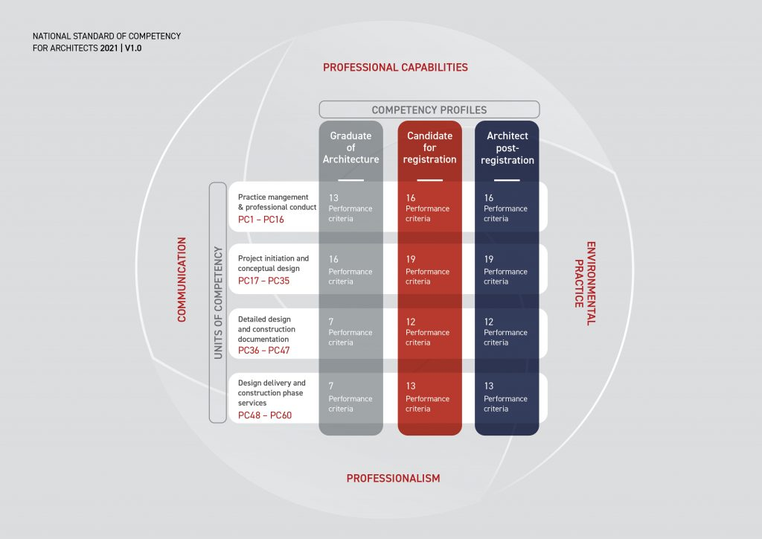
APE - Architectural Practice Examination
National Standard of Competency for Architects (2021 NSCA) (Continued)
Competency Profiles
Professional capabilities are described across three competency profiles making it clearer for the profession, academia and the consumer to understand. These profiles are:
Graduate of Architecture
Candidate for registration
Architect post-registration
Units of Competency
The 2021 NSCA consists of 4 Units of Competency covering:
Practice Management and Professional Conduct
Project Initiation and Conceptual Design
Detailed Design and Construction Documentation
Design Delivery and Construction Phase Services
which contain 60 individual Performance Criteria over the three professional capabilities and three competency profiles.

Slide 9
APE - Architectural Practice Examination
PREPARATION
Group Study with peers
Conversations with your Supervising Architect
Attending study sessions like Keith Neighbour Study Group [ACA]
Undertaking the PAL’s Program [AIA] or PARC APE Tutorials
Referring to AIA Acumen and other online resources

Slide 10
APE - Architectural Practice Examination
PART 1 – Application
Candidates applying for entry to the APE must submit the following:
Evidence of approved qualification/entry pathway
Completed application form
Completed logbook (submitted from the AACA online logbook portal)
Statement of Practical Experience (with completed APE Performance Criteria Report and where required, letters of reference)
Statutory Declaration attesting to the accuracy of all the documentation submitted
The application to sit the APE Part 1 and 2 is available on APBSA’s website and includes a checklist.
The full package is to be submitted as two separate PDFs in same order and content as the checklist.
The Logbook should be the current version from the AACA website.
The Statutory Declaration has specific wording and is found on APBSA’s website. This is a legal document with a high penalty for misleading statements.
APBSA communicate with APE candidates using email. It is important to inform us if your email changes during the examination session. Failure to do so could result in not receiving essential information.

Slide 11
APE - Architectural Practice Examination
PART 1 – Experience
All APE Part 1 candidates must have a minimum of 3300 hours of experience, ranging across all the 35 Performance Criteria required for this part. Experience must include a minimum of 12 months and 1650 hours in Australia.
The required minimum 3300 hours are subject to the following limitations:
Experience must be gained over a minimum of two years
Experience must be gained in the ten years prior to applying for the APE Part 1
Periods less than the full-time equivalent of eight weeks continuous duration should not be included.
The required minimum 3300 hours must include:
A minimum of 1650 hours (accumulated in a minimum of one year) undertaken in Australia following graduation from an approved qualification/ entry pathway
The required minimum 3300 hours may include:
A maximum of 1650 hours undertaken before graduation from an approved qualification
A maximum of 1650 hours undertaken outside Australia
Candidates may also log a maximum of 70 hours non-project work against the mandatory Performance Criteria. For example, this could include office management, office meetings (non-project related), office training / learning experiences and formal CPD for architects.
There is no longer a requirement to log experience against Observer, Participant and Executive.

Slide 12
APE - Architectural Practice Examination
PART 1 – Experience (Continued)
Practical experience
Practical experience may be gained in the following ways:
As an employee of an architectural firm under the supervision of an architect
As an employee in a firm in an allied field in the construction industry including a building design firm.
In relevant government agencies
Independently in a self-employed capacity
Experience gained in allied fields
Experience gained through independent work, work in an allied field and/or work not as an employee of an architectural firm under the supervision of an architect. This may include work for a builder, an engineer, an interior designer, a landscape architect or building designer but excludes work for a project manager, a cost consultant and a building certifier. It includes work under the supervision of an architect in allied fields.
A candidate must justify why they consider the practical experience gained in the allied field, is comparable to that gained by an employee of an architectural firm under the supervision of an architect.
Experience gained through independent work and/or through work not supervised by an architect in an architectural firm.
Candidates may also gain practical experience by working independently or as an employee not supervised by an architect in an architectural firm. This requires the level of skill described as 'application' in 2021 NSCA Explanatory Notes and Definitions. The candidate should be able to articulate how their experience demonstrates the capacity to work to this level.

Slide 13
APE - Architectural Practice Examination
PART 1 – Logbook
AACA Logbook
All APE Part 1 candidates must use the online AACA Logbook to record their practical experience.
Candidates must fill out the logbook and register with their full legal name, which corresponds to their formal identification document (for example, their passport).
Prescribed Performance Criteria
Candidates are required to gain practical experience in relation to all the 35 Performance Criteria that are mandatory to APE Part 1.
It must include:
A minimum of 35 hours experience in each of the APE Part 1 mandatory Performance Criteria
A maximum of 350 hours in any one of the APE Part 1 mandatory Performance Criteria
Candidates may also log a maximum of 70 hours non-project work against the mandatory Performance Criteria (for example, practice experience).

Slide 14
APE - Architectural Practice Examination
PART 1 – Logbook (Continued)
The logbook requires a minimum of 3300 hours of logged experience in the nominated Performance Criteria from the National Standard of Competency for Architects 2021.
Each log sheet requires the supervising architects name and registration number.
The logbook must cover only the last ten years and focus on the last two years.
Your hours must clarify work in and outside Australia.
At least one year post graduation must be in Australia.

Slide 15
APE - Architectural Practice Examination
PART 1 – Statement of Practical Experience
The Statement of Practical Experience outlines the candidate's practical experience, providing assessors with evidence that the candidate has satisfied the practical experience requirements.
The Statement should emphasise work undertaken in the two years immediately preceding the APE application. It must be presented in chronological order of experience.
The Statement of Practical Experience must include:
A one-page summary CV
Project detail pages
Completed APE Performance Criteria Report
References (where required)
Verification signature on each page prefaced by the sentence “I confirm the candidate's description of the project and the candidate’s involvement”
The candidate's name and contact details must be included on every page.
Candidates must ensure that the title 'architect' is used correctly throughout the Statement and ensure that the registration status and state registration number of the supervising architect is correct.

Slide 16
APE - Architectural Practice Examination
PART 1 – Statement of Practical Experience (Continued)
Project detail pages
These pages provide a detailed account of the candidate’s project experience.
The expected word count is 2000–3000 words, with the information provided not exceeding 3000 words.
The word count should be noted.
The project detail pages should include:
An outline of the project brief.
A detailed description of the level/type of practical experience gained by the candidate in each of the APE Part 1 mandatory Performance Criteria. This should demonstrate an understanding of the Performance Criteria.
Sufficient evidence to support the claimed experience in the online AACA Logbook.
Sufficient details to allow APE Part 3 Assessors to appreciate the scope of work, its cost, floor area and nature of construction.

Slide 17
APE - Architectural Practice Examination
PART 1 – Statement of Practical Experience (Continued)
Used by the assessors to prepare for their interview.
Must include a summary CV as an introduction (not included in the word count).
Must cover only the last ten years and focus on the last two years.
Must demonstrate that the experience addresses the Performance Criteria from the National Standard of Competency for Architects.
Must be signed off on every page by the supervising architect/s or if applicable, the appropriate professional.
Requires supervising architects name and registration number.
No images are to be included.
Must include 2 references for experience not gained under the supervision of an architect or in an allied industry.

Slide 18
APE - Architectural Practice Examination
PART 1 – Review
Administrative review is undertaken by the Registrar and the Administration Coordinator - queries may be raised from this process such as missing signatures, missing or uncertified documents and other details.
Professional review is undertaken by the Convenor and 2 assessors - to assess the candidates' applications meet the requirements for the Logbook and Statement of Practical Experience.
Intention is to close off any loose ends within a few days after the Assessor Briefing, and within two weeks of close of submissions.
You may be asked to resubmit your Application documents within a specified time period (e.g. 2-3 days) if any problems are identified.
Applicants will be advised as soon as possible of pass or fail for Part 1.

Slide 19
APE - Architectural Practice Examination
PART 1 – Common Mistakes
Make sure your Part 1 documentation is in the correct order as stipulated on the application form.
Make sure your submission is in 2 separate PDFs as stipulated on APBSA’s website.
Make sure your application form is complete and signed.
Make sure your Part 1 identification and degrees are witnessed.
Make sure your Part 1 documentation includes a completed NSCA Performance Criteria Report.
Make sure you do not include any imagery in your Statement of Practical Experience.
Make sure you have removed the AACA APE Support Material and Online Resources.
Make sure you do not refer to the old experience levels of Observer, Participant and Executive.
Make sure your Statement of Practical Experience has been signed off and verified on every page by the supervising architect or appropriate professional and is prefaced by the sentence “I confirm the candidate's description of the project and the candidate’s involvement.”

Slide 20
APE - Architectural Practice Examination
PART 2 –National Examination Paper (NEP)
The NEP will use a ‘proctored’, on-line platform, The time of the exam will be scheduled by ACER. You must ensure your computer/ laptop has video and audio capabilities and you must be in a private room setting (at home, work or elsewhere), with no one allowed to enter during the examination. If undertaking at work, check their IT network security will allow access.
Your computer will be remotely monitored during the examination.
The paper comprises an online electronic 120-minute exam (includes time allowance for reading).
There will be 80 questions comprising a mix of standalone questions and scenarios with questions. Generally, around 20 standalone questions and 12 scenarios with 5 questions, although this may vary.
No reference material, additional screens or electronic devices allowed.
Sample paper available at the AACA website https://www.aaca.org.au/wp-content/uploads/AACA-NEP-Sample-Scenario.pdf. Other sample papers in circulation may be incorrect or not be current .
Detailed results of Part 2 will be available after 4 weeks and will be provided to you and the assessors to facilitate their preparation for the interview in Part 3.

Slide 21
APE - Architectural Practice Examination
PART 3 Oral Examination
The application to sit the APE Part 3 is available on the APBSA website.
The interview is between 45 minutes and 60 minutes long.
The interview will be conducted by two assessors who are registered architects with a minimum of five years of experience. There may be a third assessor sitting in for training or quality control.
This is a competency-based assessment of your experience to confirm whether, on balance, you possess the technical knowledge and skills, and technical application of these skills in architectural practice, to be able to perform to the standard expected of an architect in Australia.
The assessors will use your logbook, statement of practical experience and results from Part 2.
The date and time of your interview will be provided on successful completion of Part 2, about 2 weeks prior to the Part 3 interview.
The assessors will declare potential conflicts of interest, as should you on receipt of your letter of invitation, if required.

Slide 22
APE - Architectural Practice Examination
PART 3 Oral Examination (Continued)
Hints
Try not to be nervous. This is your opportunity to demonstrate your knowledge as well as talk about the depth of your experience with other architects who are genuinely interested.
Keep referring to your projects to illustrate responses you give to the Assessor’s questions.
Remember that the Assessors are not trying to “catch you out”. They want you to do well at the interview.
You are not expected to “know everything”. The examination is also about demonstrating that you know where to look for information/find answers if you don’t know.
Expect to be given a few hypothetical scenarios. For example, if you have predominantly worked on multi-storey commercial buildings, you might be asked about a project at a different scale such as a small public building or house to demonstrate transferability of skills to other scales of practice.
Make sure you are familiar with the Architectural Practice Act 2009 and the South Australian Code of Conduct

Slide 23
APE - Architectural Practice Examination
Complaints
Complaints can be lodged, but it should be noted that a review of results for any Part of the APE will only occur if there is evidence of misapplication of AACA policies or procedures for the APE.
The Registrar is the designated officer to review complaints and aims to resolve these within 21 days of receipt.
Candidates are advised to read section 3.4 of the AACA Procedures for Candidates before lodging a complaint.

Slide 24
APE - Architectural Practice Examination
FAQS
Part 1 results will be informed by mail and email generally within two weeks.
Part 2 results require a longer time because there is a national moderation process involving all APE Convenors (approximately 4 weeks)
Part 3 results will be notified by email and mail generally within a week of the completion of all examination interviews.
Identification is required at each stage using your driver's license or passport.
Non-standard applications may need to be referred to the National Convener so please refer details of these to APBSA prior to lodgement.
Should there be extenuating circumstances [sickness, recent death of a family member, etc.] at any time during the examination process please ensure that you advise APBSA staff before the respective session or submission date.

Slide 25
APE - Architectural Practice Examination
KEY DATES – 2025
 | SESSION 1 | SESSION 2
BRIEFING SESSION | Tuesday 14 January | Friday 8 July
PART 1 & 2 Application opens: Application closes: | Tuesday 14 January Wednesday 29 January | Tuesday 8 July Sunday 20 July
PART 2 National Examination Paper | Tuesday 8 April | Tuesday 16 September
PART 3: Application opens: Application closes: | Tuesday 6 May Sunday 18 May | Tuesday 14 October Wednesday 29 October
PART 3 Examination by Interview | Commencing 10 June | Commencing 17 November

Slide 26
APE - Architectural Practice Examination
LEGISLATION
Architectural Practice Act 2009 https://www.archboardsa.org.au/assets/Uploads/2012-01-01-Revised-Act.pdf
Architectural Practice [General] Regulations 2010 https://www.legislation.sa.gov.au/__legislation/lz/c/r/architectural%20practice%20(general)%20regulations%202010/current/2010.221.auth.pdf
The Architects’ Code of Conduct https://www.archboardsa.org.au/assets/Uploads/2023-9-7-Code-of-Conduct3.pdf
Continuing Professional Development Amendments to the Architectural Practice Act 2009 https://www.archboardsa.org.au/assets/pdf-files/Guidance-Note-04-Continuing-Architectural-Education.pdf

Slide 27
APE - Architectural Practice Examination
AACA RESOURCES
2021 NSCA 2021-NSCA.pdf (aaca.org.au)
Explanatory Notes 2021-NSCA-Explanatory-Notes.pdf (aaca.org.au)
APE Candidate Handbook APE-2024-candidate-handbook.pdf (aaca.org.au)
APE Information Sheet APE-information-sheet.pdf (aaca.org.au)
APE Support Material APE-2024-support-material.pdf (aaca.org.au)
APE Checklist APE-checklist.pdf (aaca.org.au)
APE Performance Criteria Report APE-submission-pc-report.pdf (aaca.org.au)
APE NSCA Mapping APE-NSCA-mapping.pdf (aaca.org.au)
APE NEP Remote Proctoring FAQS APE-remote-proctoring-FAQS.pdf (aaca.org.au)

Slide 28
APE - Architectural Practice Examination
AACA VIDEO RESOURCES
Video 1: 2021 National Standard of Competency for Architects (30 mins)
How the NSCA is used and influences the Architectural Practice Exam - https://youtu.be/68SOidRME-Y
Video 2: Architectural Practice Exam Part 1, 2 + 3 (30 mins)
For candidates applying from 2024, what to expect, tips and guides for how to use the AACA resources - https://youtu.be/-IJejEbsqgw
Video 3: Understanding the NCC
Part 1 (44 minutes)
Introduction - https://www.youtube.com/watch?v=ImX_5QEocic
Section 1. Understanding the NCC (Volume One, Two and Three) - https://www.youtube.com/watch?v=Zqt72C_zlsk
Section 2. Understanding performance-based code - https://www.youtube.com/watch?v=Maoewqi1GJQ
Part 2 (33 minutes)
Section 3. Understanding NCC building classifications - https://www.youtube.com/watch?v=ALreHYNICvQ
Section 4. Using NCC Volume One {commercial) - https://www.youtube.com/watch?v=pSIbzaq4He8
Section 5. Using NCC Volume Two (residential - https://www.youtube.com/watch?v=GNL8ceF4Xek

Slide 29
APE - Architectural Practice Examination
AACA VIDEO RESOURCES (Continued)
Video 4: Understanding Fire Safety in the NCC
Part 1 (48 minutes)
Introduction - https://www.youtube.com/watch?v=ZbyKT1uTbxE
Section 1. Understanding Fire Safety in the NCC - https://www.youtube.com/watch?v=Wx46wvfGK10
Section 2. Using the Fire Safety provisions of NCC Volume One https://www.youtube.com/watch?v=Wk7X62PUiSQ
Part 2 (20 minutes)
Section 3. Using the Fire Safety Provisions of NCC Volume Two https://www.youtube.com/watch?v=dVtXurGAwLU
Video 5: Understanding and Using Energy Provisions in the NCC
Part 1 (30 minutes)
Introduction - https://www.youtube.com/watch?v=GYhbJrvU2Ig
Section 1. Understanding Energy Efficiency in the NCC - https://www.youtube.com/watch?v=L6xyJ9BqNKs
Part 2 (53 minutes)
Section 2. Using Energy Efficiency Provisions in Volume One - https://www.youtube.com/watch?v=L6xyJ9BqNKs
Section 3. Using Energy Efficiency Provisions in Volume Two - https://www.youtube.com/watch?v=eY7s9GSjM9g

Slide 30
APE - Architectural Practice Examination
ANY QUESTIONS?

Slide 31
Thank you for your attendance.
This presentation is available now on the APBSA website.
2025

